Slide 1
LAND SEARCH / RESCUE TRAINING

Slide 2
INITIAL GOALS
Identify the training needs for responding to a land search and rescue.
Training to be at no cost to AARS members.
Single day classes to increase volunteer participation.
Build regional teams with common training for use in larger scale operations.
Build an AARS instructor cadre for AARS courses.

Slide 3
TRAINING NEEDS FOR LAND SAR
Ability to assist with organizing the initial response to a lost or missing person using proven search concepts and tactics.
Ability to organize and work within an ICS system.
Ability to efficiently build common incident mapping that all searchers have immediate access to.
Ability to navigate and track searchers and resources during missions.
Ability to assist in a technical rescue environment.

Slide 4
PROPOSED COURSES OF STUDY
Search and Rescue Fundamentals
Initial Response / Initial Actions
CalTopo / SarTopo
Land Navigation
Basic Rescuer Program
Swiftwater Awareness

Slide 5
Search and Rescue Fundamentals
Classroom (6-8 hours) with tabletop exercises
ICS system
Planning
Effective use of resources
Search concepts / tactics
Gear and equipment

Slide 6
Initial Response
Classroom (5-6 hours) with tabletop and field exercises
Initial action steps
Creating a functioning organization / building a foundation
Preparing for future operational periods
Managing resources
Initial search tactics

Slide 7
CalTopo / SarTopo
Classroom (4-5 hours) with tabletop and field exercises
How to build incident management search maps
Tracking searchers and resources
Using the system offline

Slide 8
Land Navigation
Classroom (8-10 hours) with field exercises
How to navigate using map and compass
How to integrate map, compass and GPS
Understanding and using grid coordinate systems

Slide 9
Basic Rescuer
Classroom (8 hours) with field exercises
Basic training for a person who participates in rope rescue as part of a larger rescue duty.

Slide 10
Swiftwater Awareness
TEEX online course (2 hours)
Minimum awareness course for working around swiftwater in a wilderness environment

Slide 11
ACCEPTABLE EQUIVALENTS
Intro to Search and Rescue: Current NASAR SARTECH III, II or I, or other ASTM F2209-20 compliant course or NFPA 1006 compliant course (minimum NFPA 1006-2021 11.1 and 11.2).
AARS Basic Rescuer: ASTM F2752-19 or NFPA 1006 Rope Rescue compliant course (minimum NFPA 1006-2021 5.1 and 5.2).
TEEX Swiftwater: NFPA 1006 Swiftwater Rescue compliant course (NFPA 1006-2021 18.1 or higher).

Slide 12
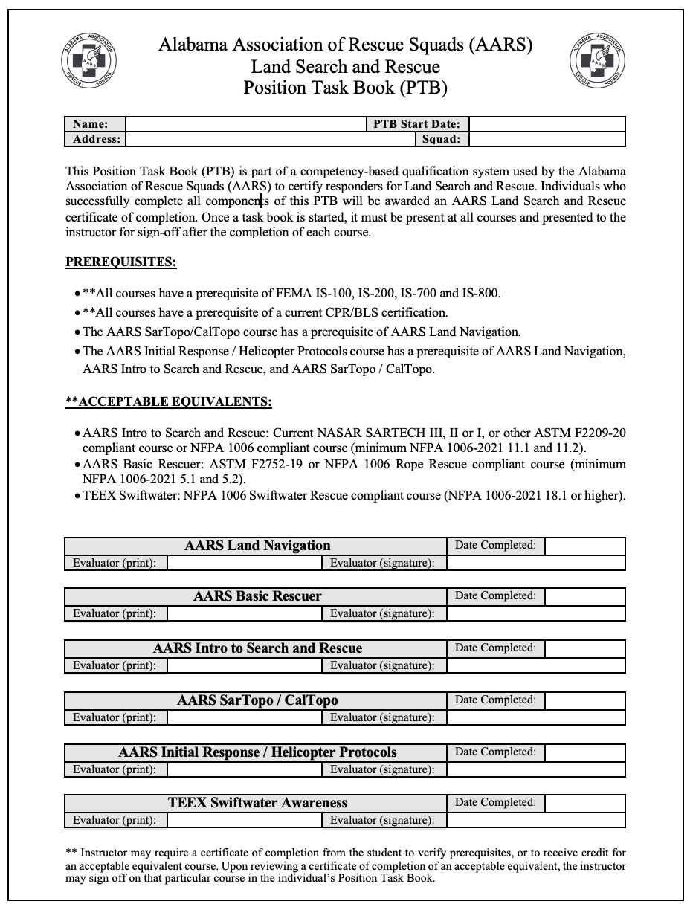
POSITION TASK BOOK
Single book that the candidate keeps up with.
Instructor/evaluator signs off on each course upon satisfactory completion.
Once all courses have been completed and signed off, candidate sends the PTB to AARS for approval and certification.

Slide 13
INSTRUCTOR QUALIFICATION

